Slide 2
Digital Forensics Lecture-12
By- Dr.subhranil Das
Assistant Professor
School of computer Science

Slide 3

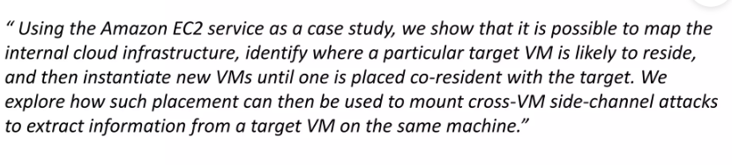
Side Channel Attacks

Slide 4
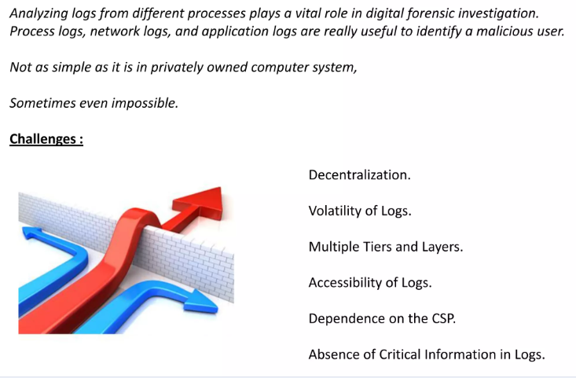
Logging

Slide 5
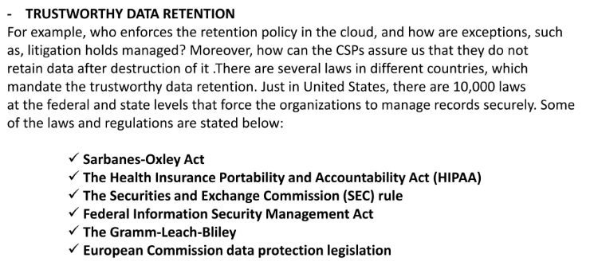
Crime Scene Reconstruction

Slide 6
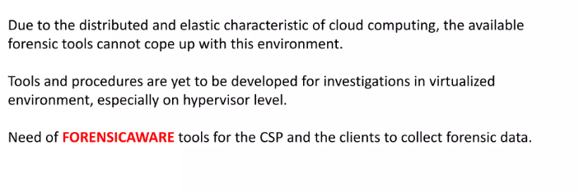
Limitations of Current Forensic Tools

Slide 7
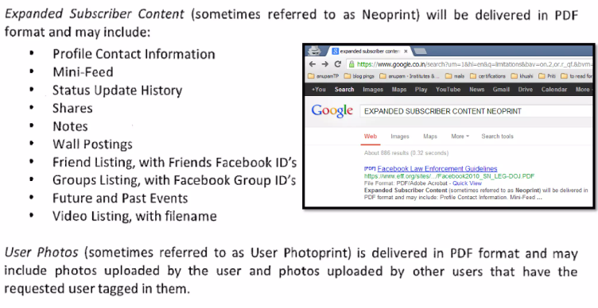
Forensics Today

Slide 8
Proposed Current Solutions of Cloud Forensics

Slide 9
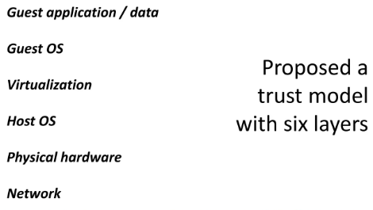
Building a Trust Model

Slide 10
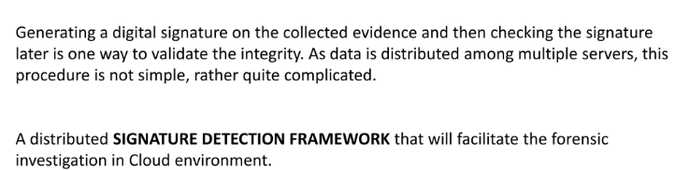
Integrity Preservation

Slide 11
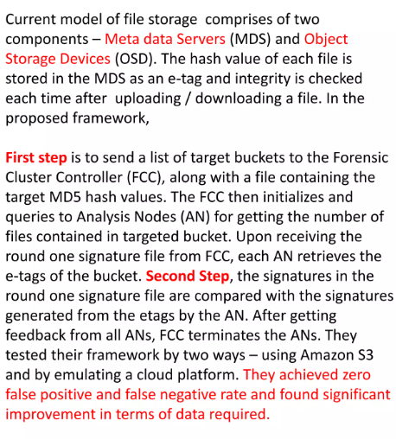
Signature Detection Framework

Slide 12
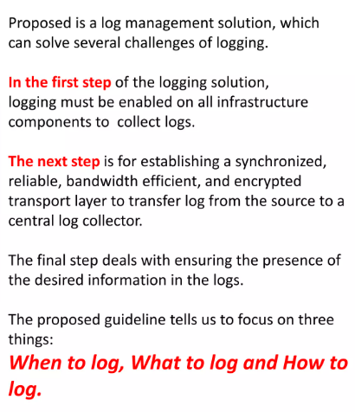
Log Management System

Slide 13
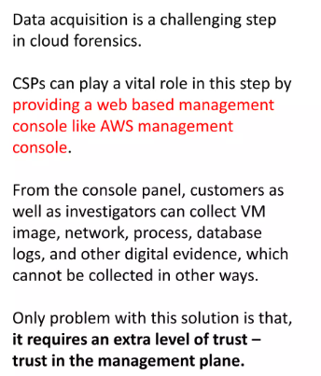
Cloud Management System

Slide 14
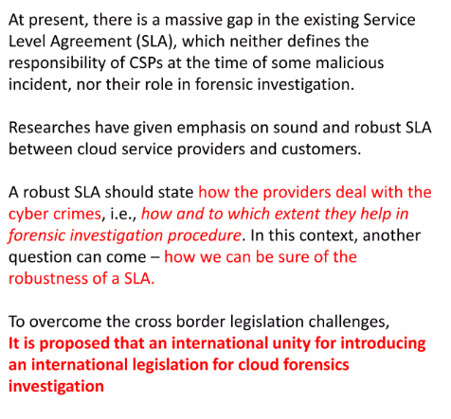
Solution of Legal Issues

Slide 15
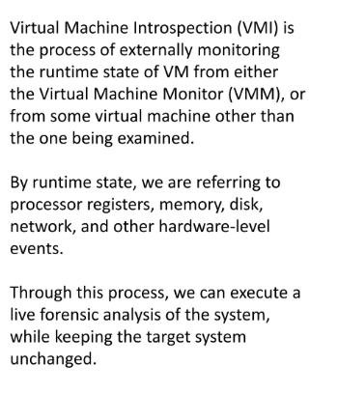
Virtual Machine Introspection (VMI)

Slide 16
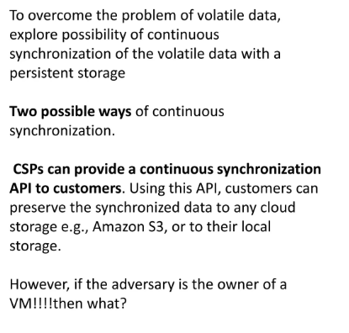
Continuous Synchronization

Slide 17
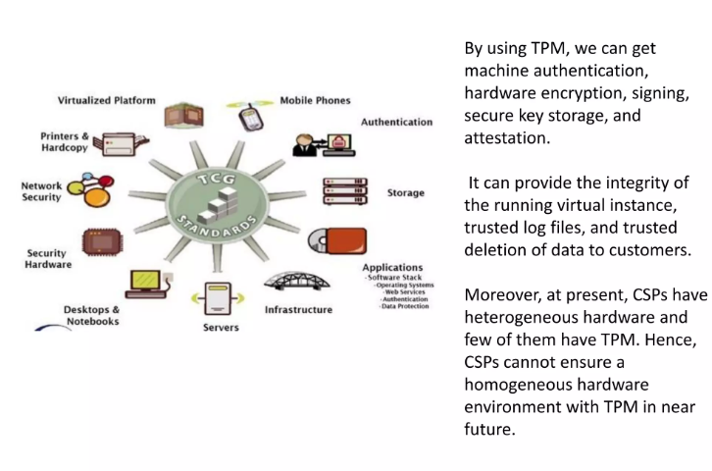
Trusted Platform Module (TPM)

Slide 18
Next Lecture
Cloud Forensics

